Slide 1
Lettuce Growth Dataset
Akshaj Kammari

Slide 2
Description
Dataset Link
“This comprehensive dataset provides valuable insights into the growth patterns of various plants under different environmental conditions. Collected over time, it offers a detailed view of how factors such as temperature, humidity, pH level, and Total Dissolved Solids (TDS) affect the growth stages and development of these plants.”

Slide 3
Attributes
Here are some attributes we will be using:
Plant_ID: Identifier for each plant.
Date: The date of the observation.
Temperature (°C): The temperature in degrees Celsius.
Humidity (%): The humidity level in percentage.
TDS Value (ppm): The Total Dissolved Solids value in parts per million.
pH Level: The pH level of the environment.
Growth Days: The number of days since the plant started growing until fully grown.

Slide 4
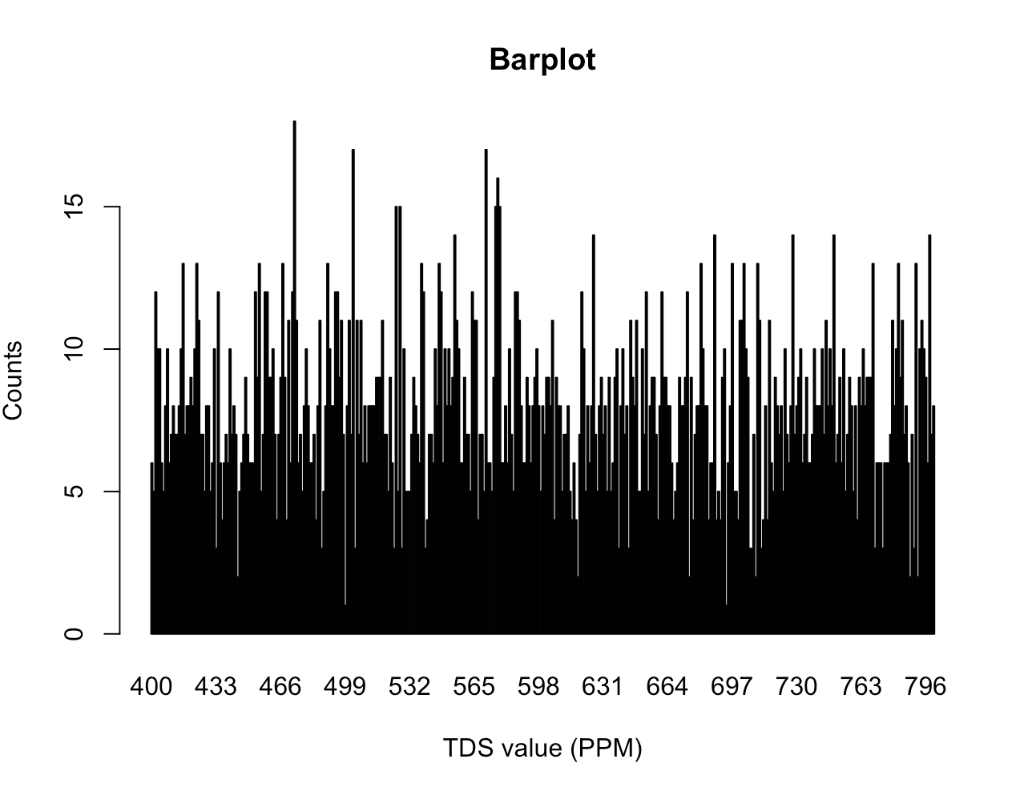
Barplot
This barplot is particularly important because it visualizes the count of dissolved substances in water, which are vital in measuring nutrient availability, root health, and crop quality/yield and profitability to name a few.

Slide 5
R code for Barplot
counts <- table(lettuce$`TDS Value (ppm)`)
barplot(counts, main = "Barplot", xlab = "TDS value (PPM)", ylab = "Counts", col = "lightblue")

Slide 6
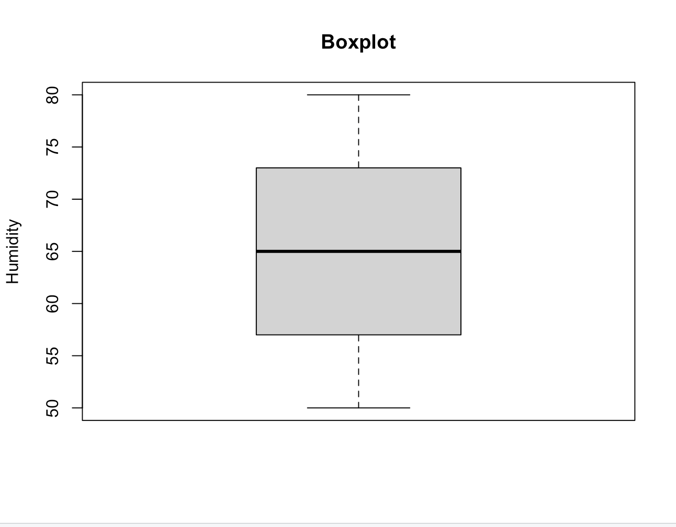
Boxplot
This boxplot shows the humidity of lettuce, which is important because it directly affects the growth, health, and quality of lettuce plants. A couple of the factors that are affected by humidity are transpiration and water uptake, temperature regulation, disease prevention, and growth.

Slide 7
R code for Barplot
boxplot(lettuce$`Humidity (%)`, main = "Boxplot", ylab = "Humidity")

Slide 8
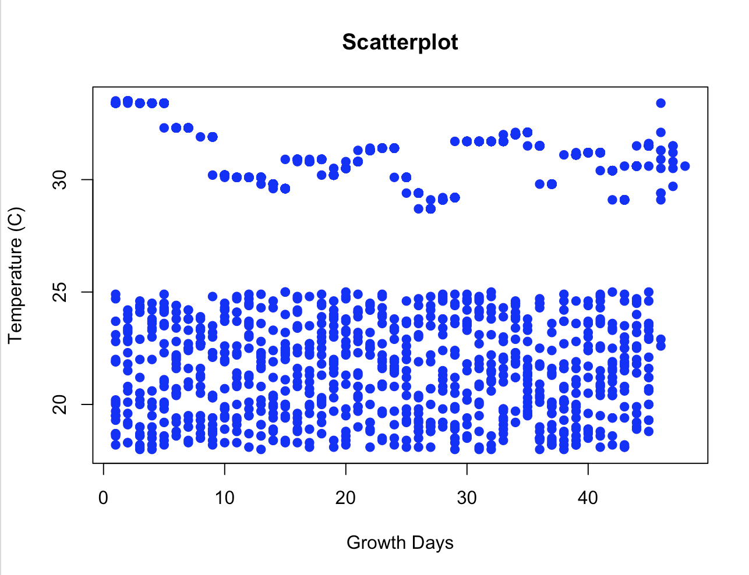
Scatterplot
The growth of lettuce is closely correlated with both the number of days it has been growing and the temperature conditions it experiences. Some factors that it may influence include germination, vegetative growth, harvest timing, color and flavor, etc.

Slide 9
R code for a Scatterplot
plot(lettuce$`Growth Days`, lettuce$`Temperature (°C)`, main = "Scatterplot", xlab = "Growth Days", ylab = "Temperature (C)", col = "blue", pch = 19)

Slide 10
Summary Part 1
The availability of a comprehensive dataset that meticulously documents the growth patterns of lettuce plants under diverse environmental conditions is profoundly intriguing and holds significant scientific and practical implications. This dataset offers a wealth of insights into the intricate relationship between environmental factors and the growth of lettuce plants, shedding light on various facets of plant biology, agriculture, and sustainability.
Firstly, the dataset's value lies in its potential to enhance our understanding of plant physiology and adaptation. By systematically tracking the growth stages and development of lettuce plants in response to different environmental conditions, researchers can unravel the underlying mechanisms that govern plant responses. For instance, it can help elucidate how temperature fluctuations influence germination rates, leaf expansion, and flowering in lettuce plants. Understanding these dynamics is crucial for optimizing agricultural practices and crop yield, particularly in the face of climate change, where fluctuating temperatures have become increasingly common.

Slide 11
Summary Part 2
Moreover, this dataset can serve as a valuable resource for agricultural scientists and farmers alike. It offers practical insights into how to cultivate lettuce more effectively, taking into account specific environmental variables. Farmers can use this information to make informed decisions regarding planting times, irrigation schedules, and greenhouse conditions, ultimately leading to improved crop yields and resource efficiency. Additionally, it can facilitate the development of more resilient lettuce varieties that can thrive in a range of environmental conditions, contributing to food security and sustainability efforts.
Another fascinating aspect of this dataset is its relevance to hydroponics and controlled-environment agriculture (CEA). As these methods gain popularity for their resource-efficient and year-round crop production capabilities, understanding how lettuce plants respond to different levels of Total Dissolved Solids (TDS), pH levels, and humidity becomes essential. The dataset can provide essential insights into the optimal nutrient concentrations and environmental conditions for hydroponic lettuce cultivation, enabling more precise and efficient hydroponic systems.

Slide 12
Summary Part 3
In the context of data science and machine learning, this dataset is a goldmine for researchers seeking to develop predictive models. By leveraging machine learning algorithms, scientists can build models that forecast lettuce growth based on historical data, environmental conditions, and potentially even predict optimal conditions for desired outcomes. These predictive models can have practical applications in precision agriculture, guiding real-time decisions for crop management.
In conclusion, this comprehensive dataset documenting the growth patterns of lettuce plants under varying environmental conditions is captivating due to its multifaceted implications. It not only deepens our understanding of plant biology and adaptation but also has practical applications in agriculture, hydroponics, and environmental conservation. Moreover, its long-term nature and potential for predictive modeling make it an invaluable resource for advancing both scientific research and sustainable practices in the cultivation of lettuce and other crops. This dataset represents a significant step toward a more resilient and informed approach to agriculture and environmental management.

